Slide 1

Multi-Parameter Air Quality Monitoring System
Rahima Akter Happy
Class ID :09 Batch: 68
Department: Public Administration

Slide 2

Abstract
• The study aims to understand the spatial and categorical variations in air quality metrics, providing insights into pollution levels across different regions.
• This report includes detailed analyses of AQI components, such as CO, Ozone, NO2, and PM2.5, categorized into respective AQI values and categories.
• Furthermore, it identifies trends, highlights potential limitations, and offers actionable recommendations for air quality management.

Slide 3
Introduction
Air quality monitoring is a critical component of environmental management as it provides crucial data to assess and mitigate pollution’s impact on public health and the environment.
This dataset contains diverse parameters including geographical coordinates, AQI values for various pollutants, and their respective categories.

Slide 4
Data Set Analysis
Country City: Location of air quality measurement AQI Value Category: Overall Air Quality Index its classification (Good, Moderate, Unhealthy) CO AQI Value Category: Carbon Monoxide levels category Ozone AQI Value Category: Ozone concentration category NO AQI Value Category: Nitrogen Dioxide levels category PM2.5 AQI Value Category: Particulate Matter (PM2.5) levels category

Slide 5
Methodology
The following steps were undertaken to analyze the dataset:
Data Cleaning: Verified data integrity, removed duplicates, and addressed any missing or inconsistent values.
Descriptive Statistics: Summarized AQI values and categories for key pollutants.
Geospatial Analysis: Mapped AQI values using latitude and longitude to visualize regional variations.
Categorical Analysis: Examined the distribution of AQI categories (e.g., Good, Moderate, Unhealthy) for each pollutant.
Trend Identification: Analyzed correlations between pollutants and their impact on overall AQI.
Question Analysis: Addressed queries in sheets A1 through A8 using dataset insights.

Slide 6
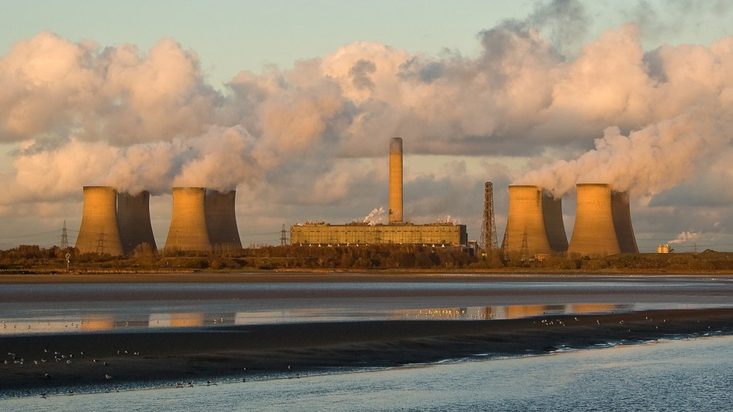
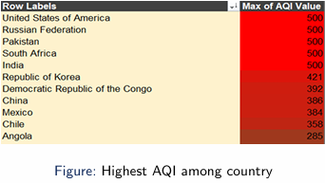
Results
1.Highest AQI Country: The city with the highest AQI value is USA ,Russia ,Pakistan ,South Africa and India with an AQI value of 500.

Slide 7
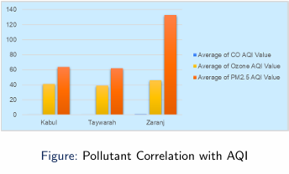
Results
2.Pollutant Correlation with AQI: Among pollutants, PM2.5 AQI shows the strongest correlation with overall AQI,Kabul,Taywarah ,Zaranj are highlighting its significant role in determining air quality.

Slide 8
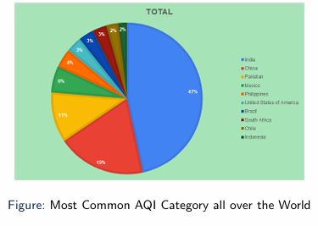
Results
3.The most frequent AQI category across all cities is Good, indicating relatively clean air in a large portion of the dataset.

Slide 9
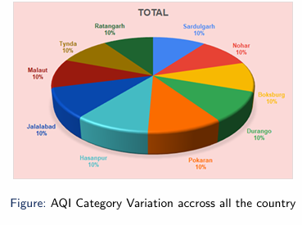
Results
4.Variations in AQI categories suggest urban areas are more likely to experience higher pollution levels, while smaller cities or regions with natural surroundings tend to fall into the ”Good” category..

Slide 10

Limitations
Data Gaps: Limited coverage in some regions.
No Time-Series: Lacks trends forseasonal/diurnal analysis.
Missing Sources: No data on pollutant origins.

Slide 11
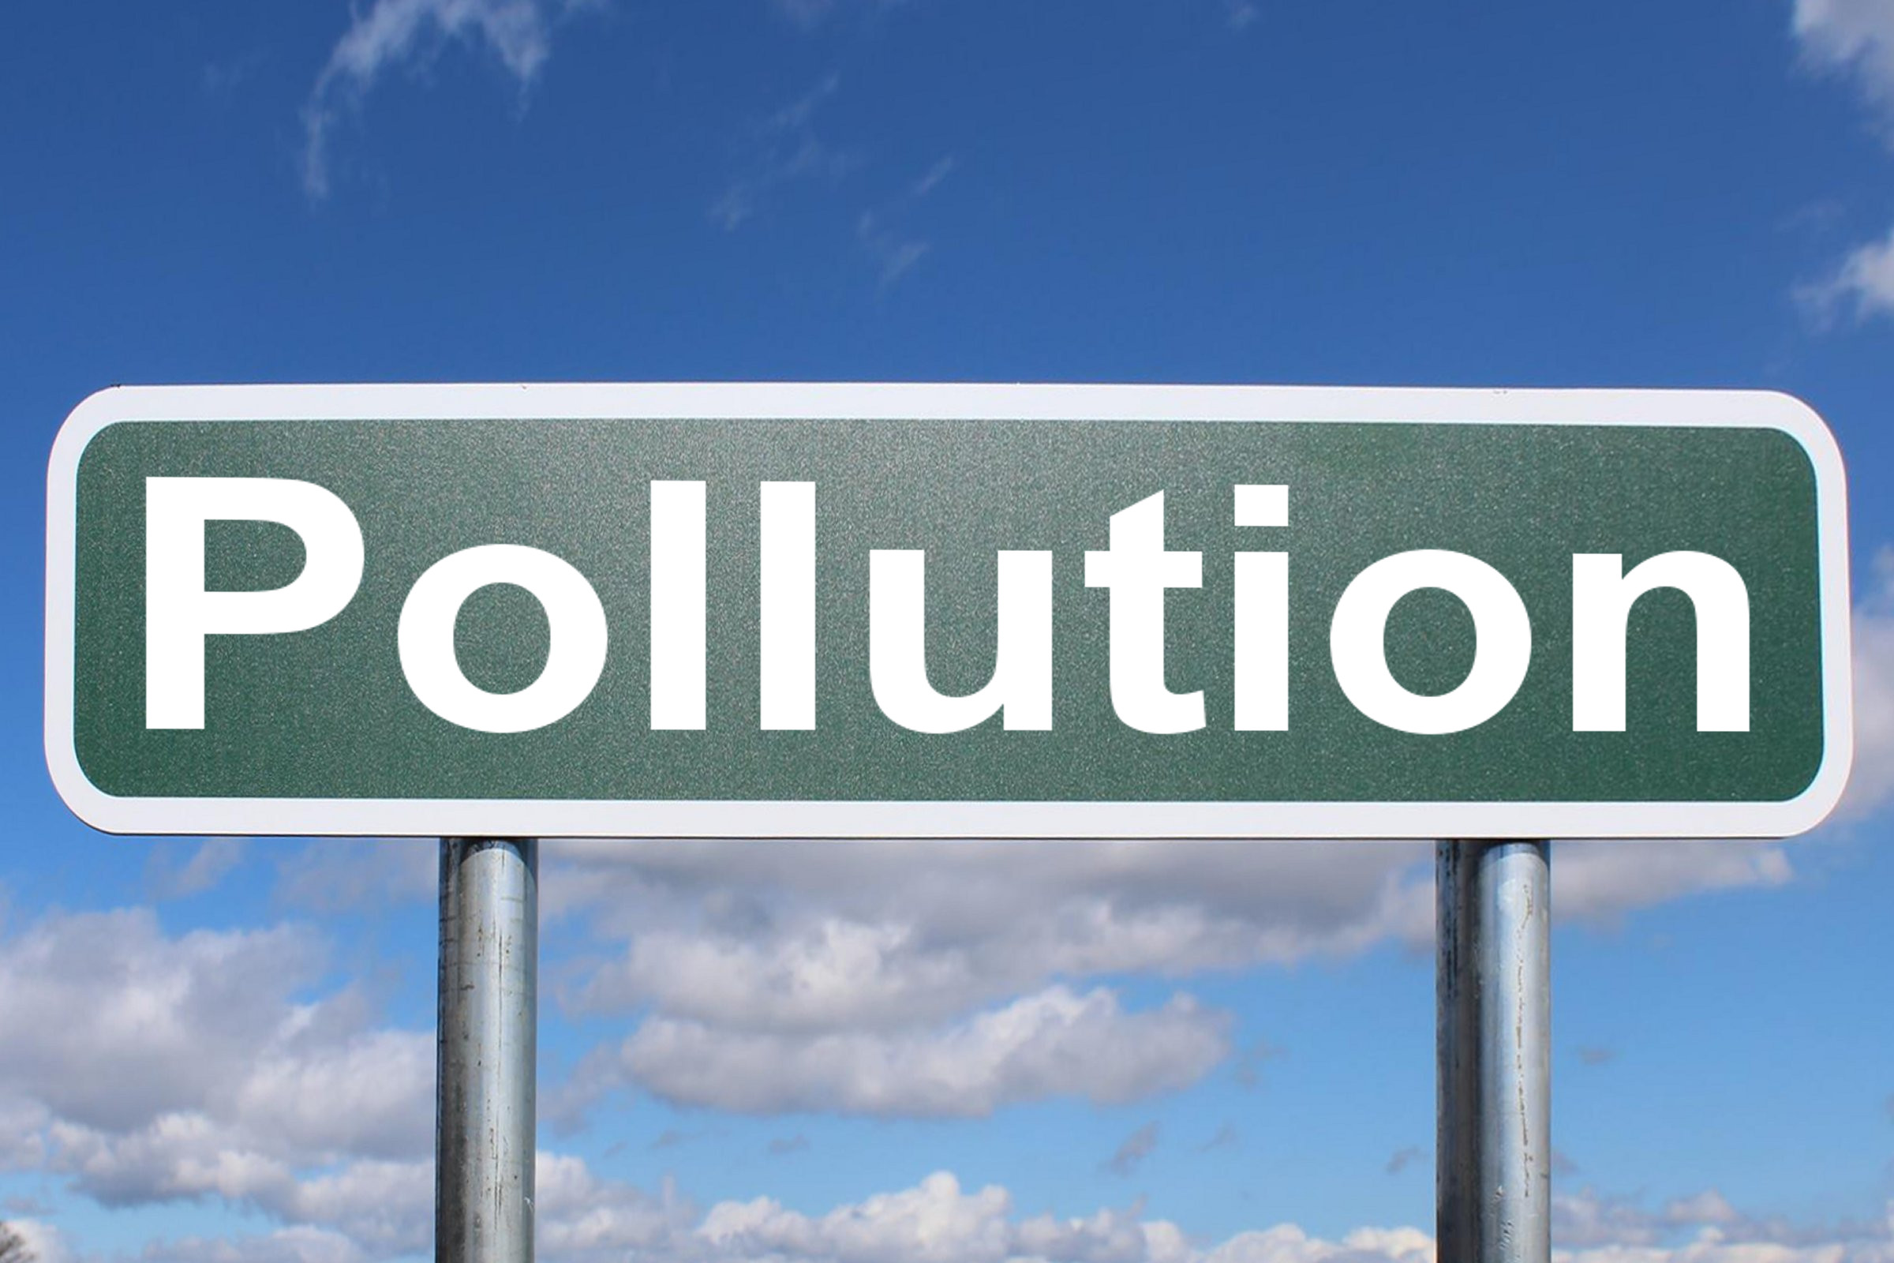
Conclusion and Recommendations
This report underscores the value of multi-parameter air quality monitoring in identifying pollution hotspots and informing mitigation strategies. While the dataset offers significant insights, addressing its limitations would enhance its utility.
Further Statistical and Sustaianbale pollution management is needed for safer our planet .
Expand Coverage: Include more regions with uniform data standards. Add Temporal Data: Enable seasonal and daily trend analysis. Identify Sources: Integrate emission source information. Policy Use: Support regulations and urban planning.

Slide 12

THANK YOU

